Slide 1

Y5/6 Residential trip to Maes-y-nant
19th-21st March 2025

Slide 2
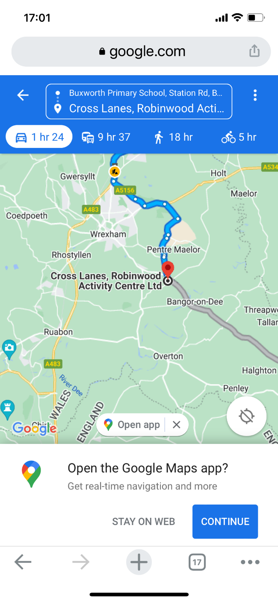
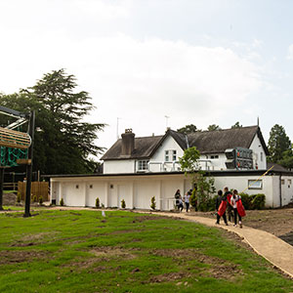
So, where is it? How long will the coach journey take?
The centre is in Wrexham.
The journey will take approximately 1hr 50 minutes by coach

Slide 3
Example Activity Plans
During our stay at Robinwood we will be partaking in a number of Adventurous outdoor activities :
Canoeing and raft building
Giant swing
Archery
Zip wires
Indoor climbing and Trapeze
Problem solving, The Quest and the Piranha Pool
Caving
Dungeon Problem
Trapeze (This activity is only available in Wales at this centre as it has a high ropes course).

Slide 4
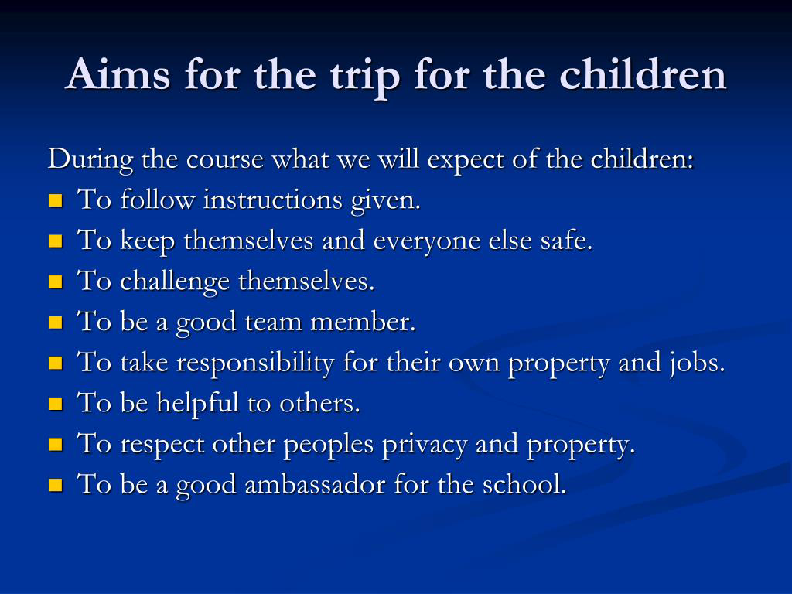

Slide 5
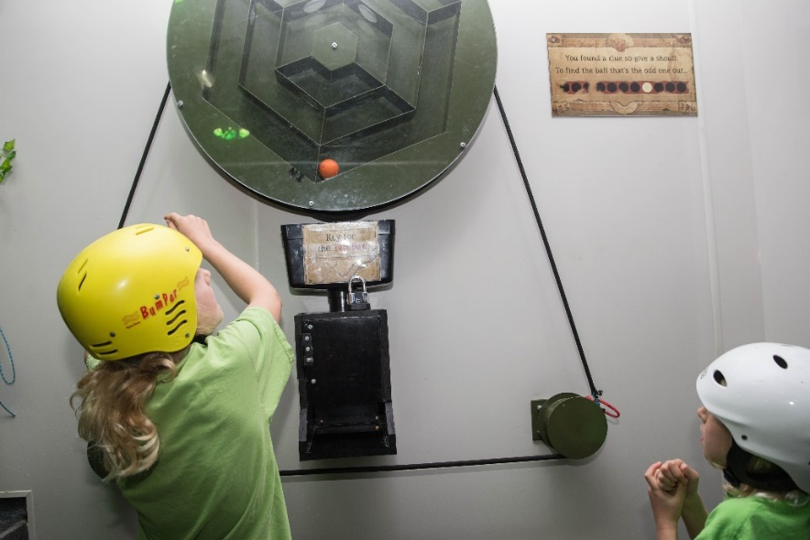
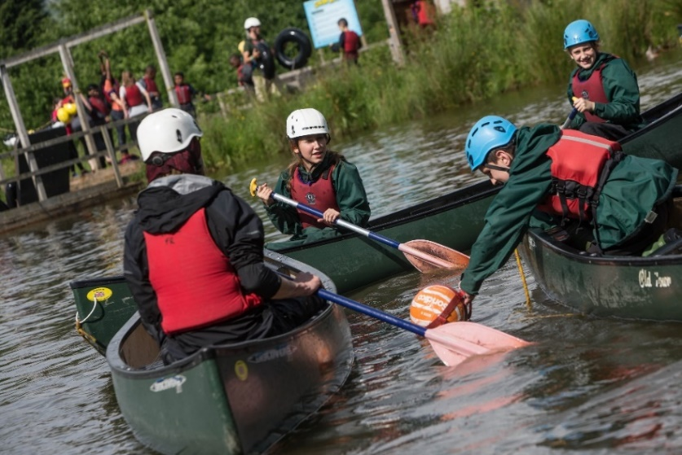
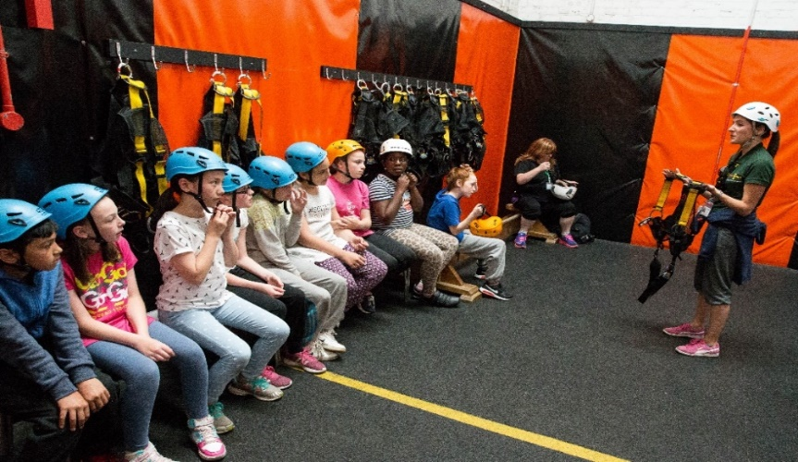
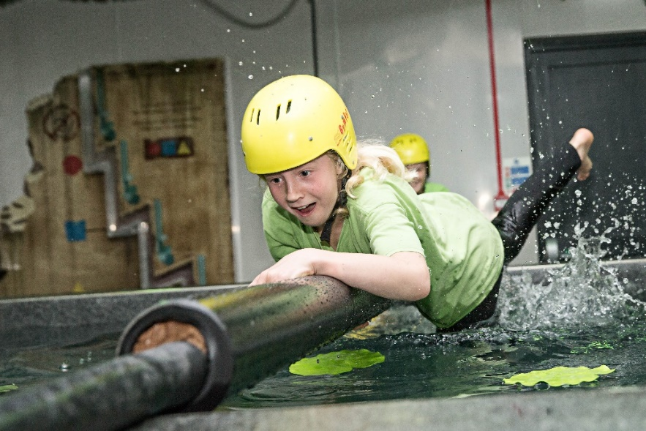
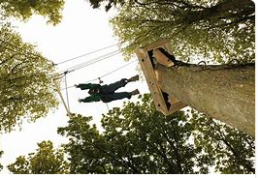
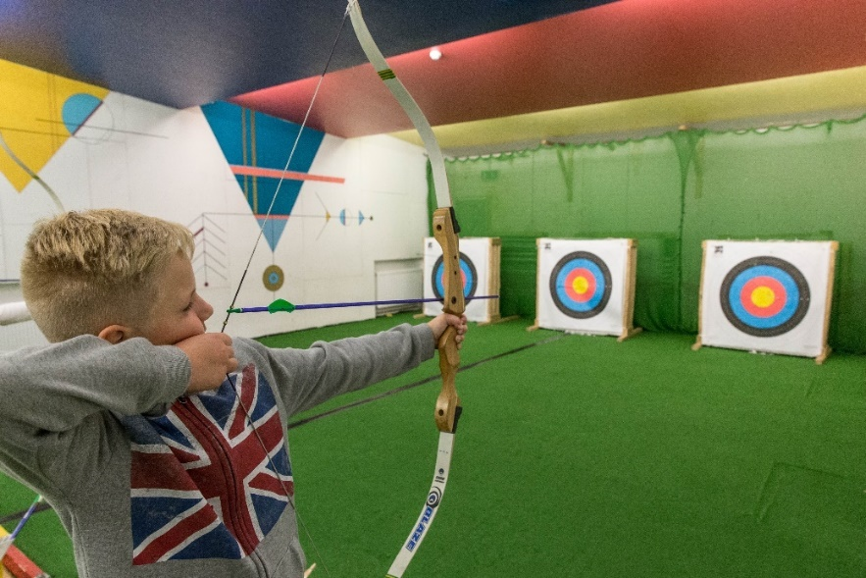
Photographs of some of the activities
Notes:
Archery, Climbing, Canoeing, Problem solving, Piranah Pool

Slide 6
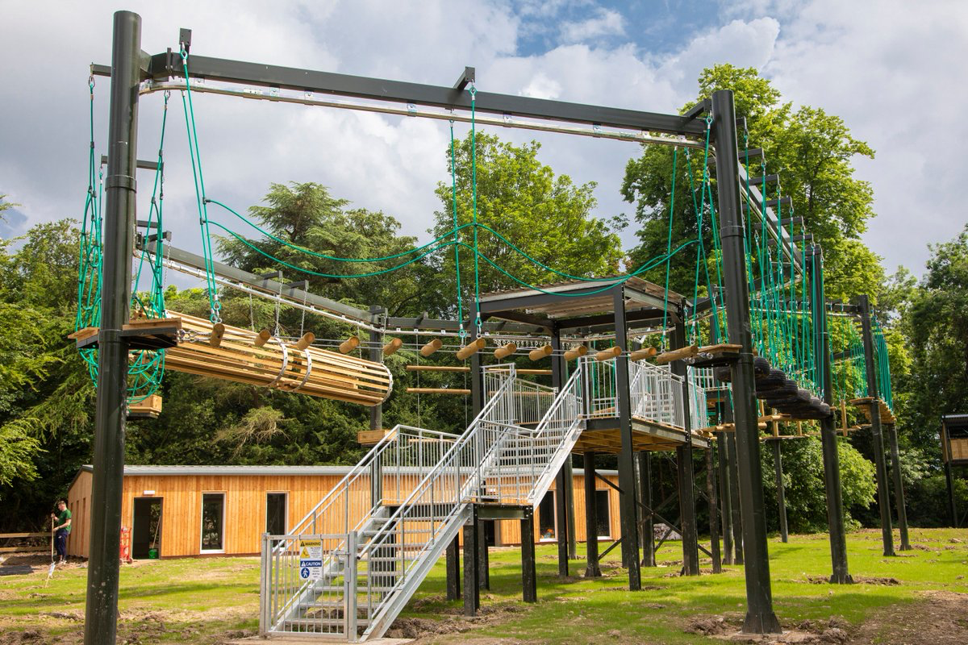
High Ropes and Trapeze course

Slide 7
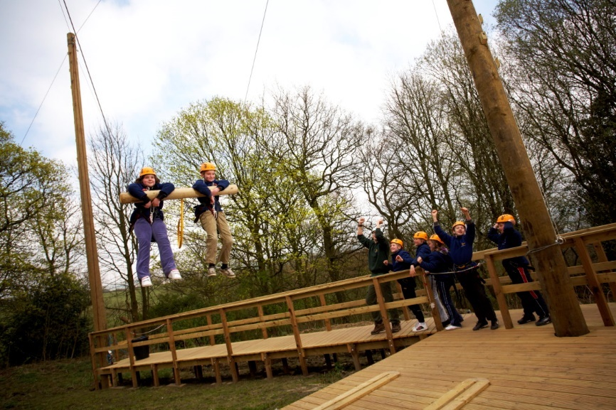
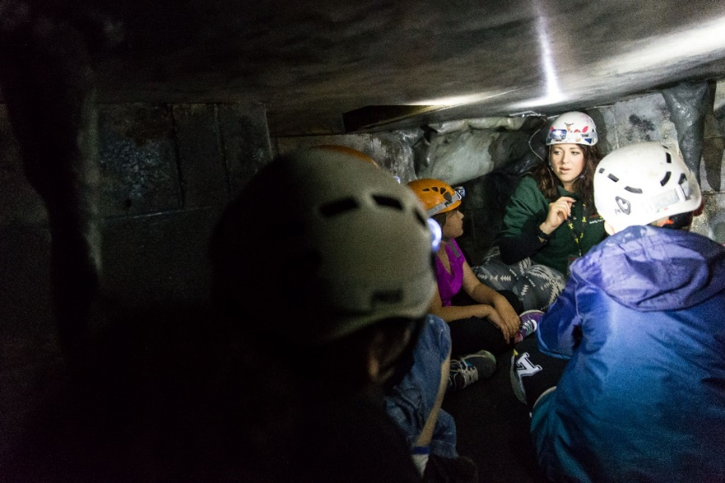
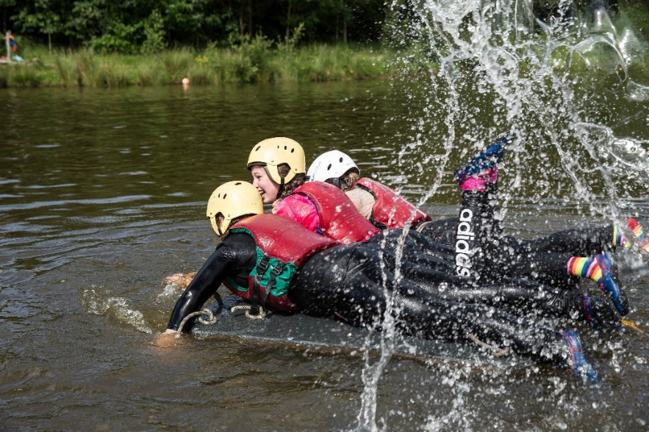
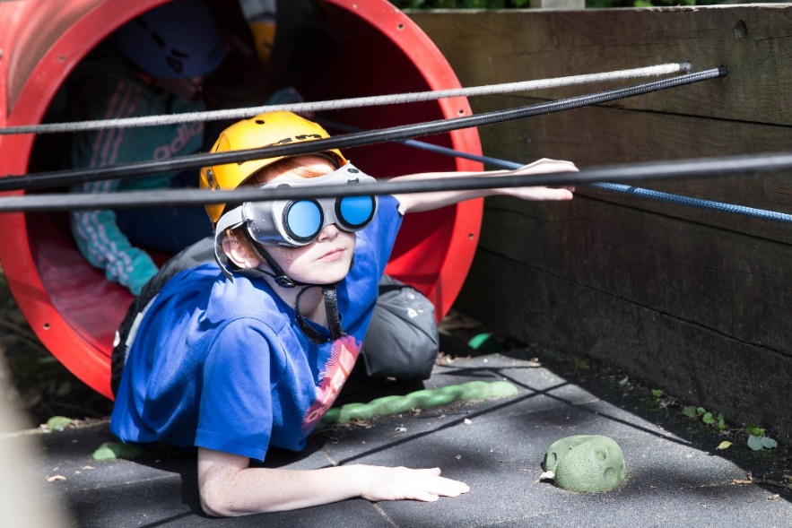
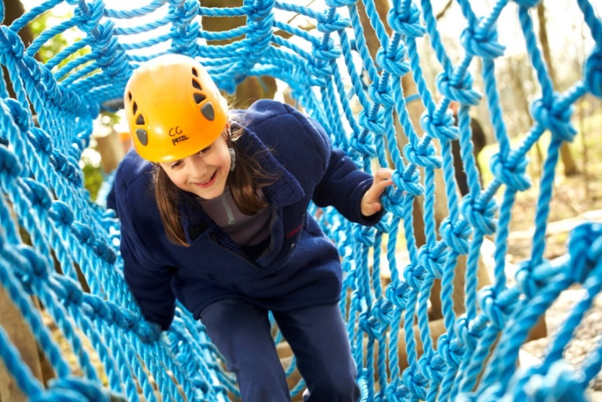
Photographs of some of the activities
Notes:
Caving , Team swing, Raft building, Quest , Outdoor adventure course

Slide 8
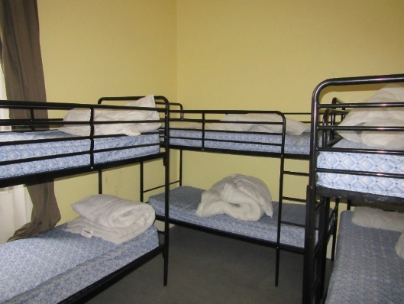
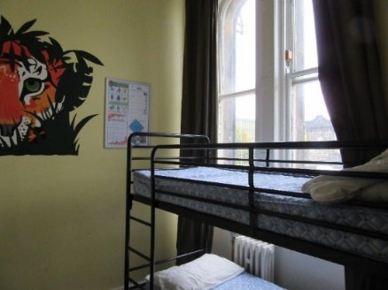
What happens overnight
The children will be split into boys and girls dormitories- all children have chosen at least one room buddy to be with.
Robinwood have staff on duty overnight who monitor the rooms alongside the Buxworth staff.
Robinwood provide all the bedding required and have spares if required. We have used the information that you have given to us on the form.
Robinwood and Buxworth staff have set the times of lights out and for getting up in the morning.
The staff will wake the children in the morning and tell them what they will need for the day ahead at breakfast time.
The children will be super tired at the end of each day. Their schedule is non-stop from 7.30am- 8.00pm!
There is very little time to miss home!

Slide 9
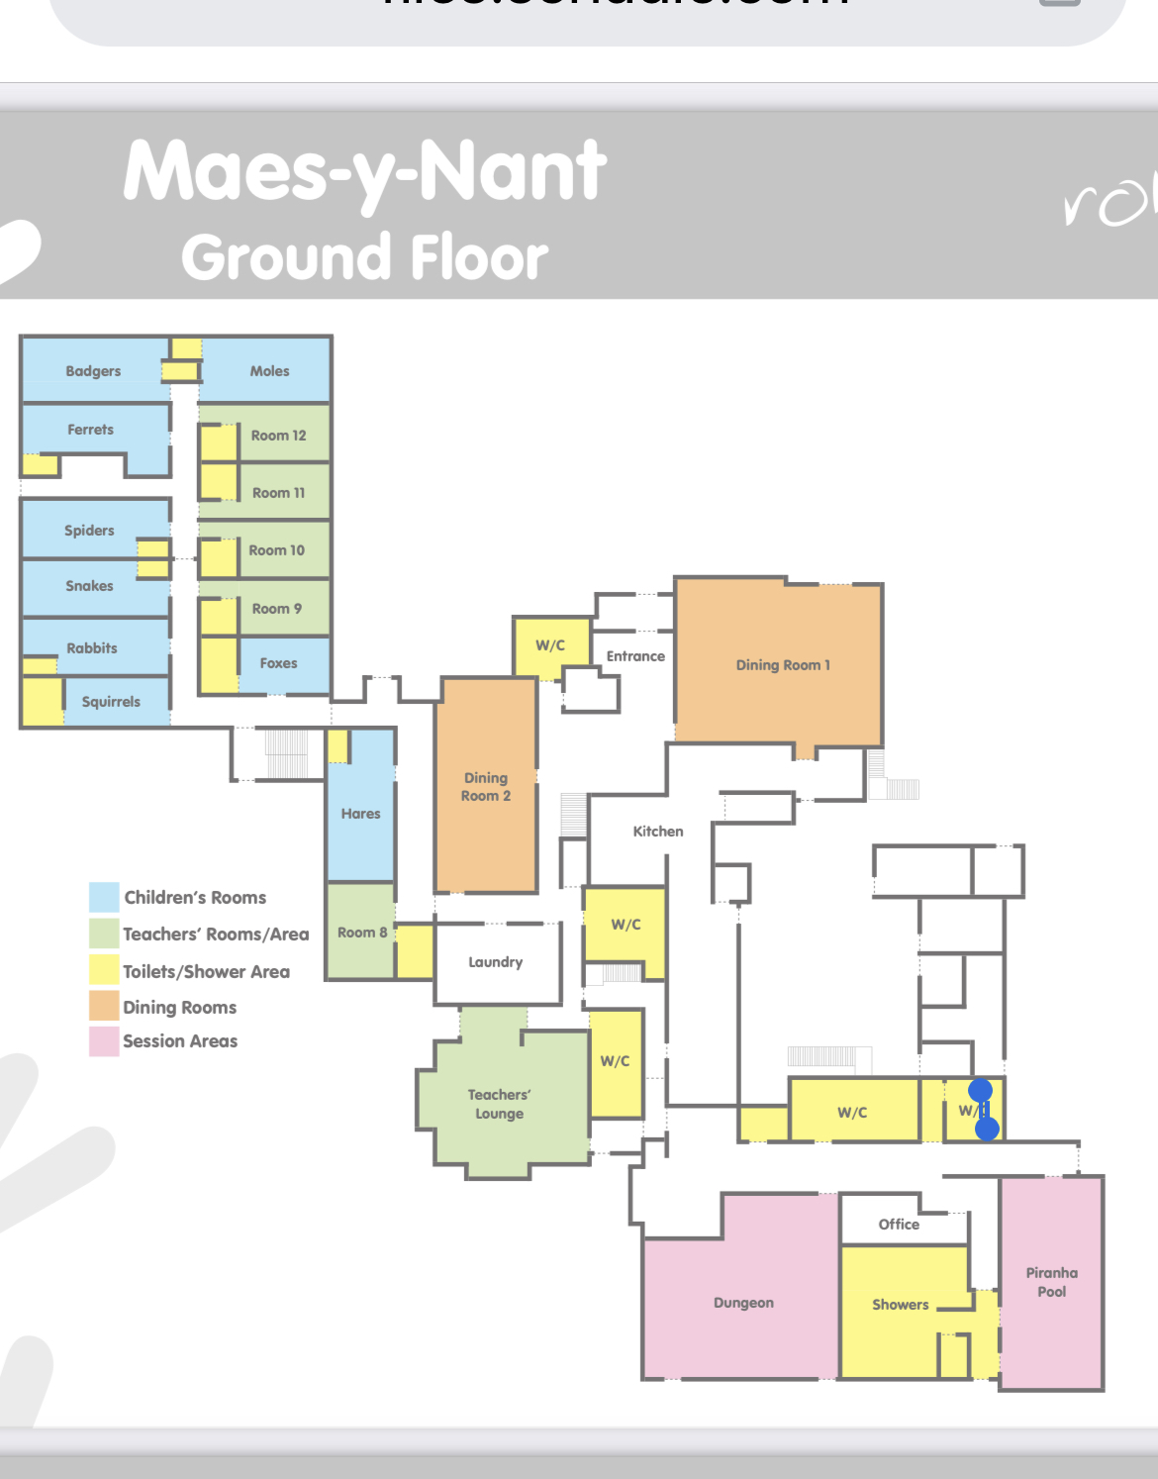

Slide 10
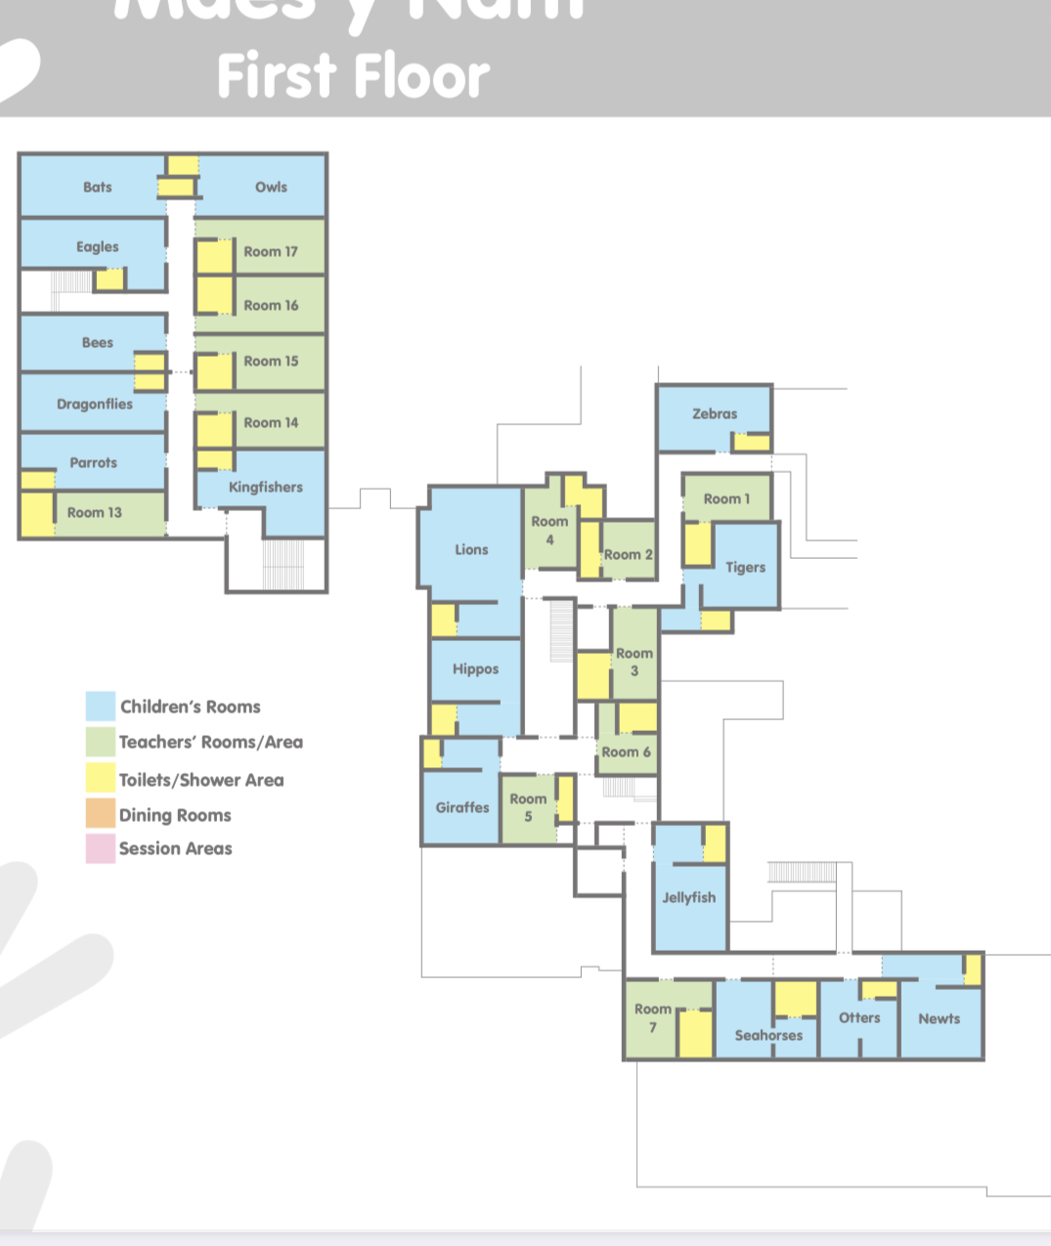

Slide 11


Slide 12
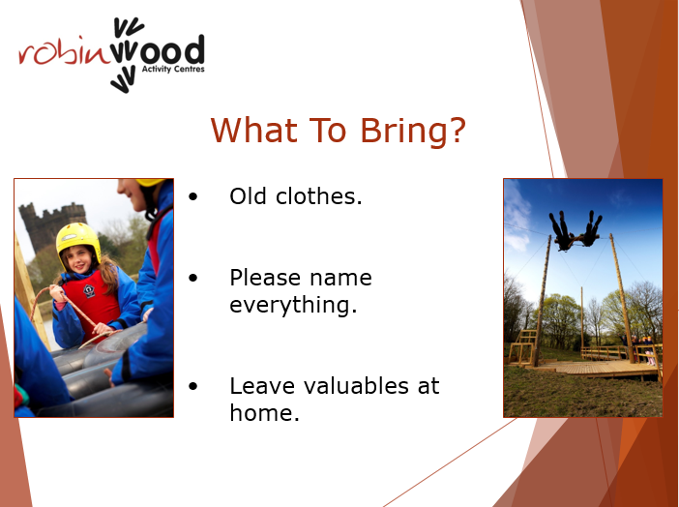
Notes:
Remember no electronics at all.

Slide 13
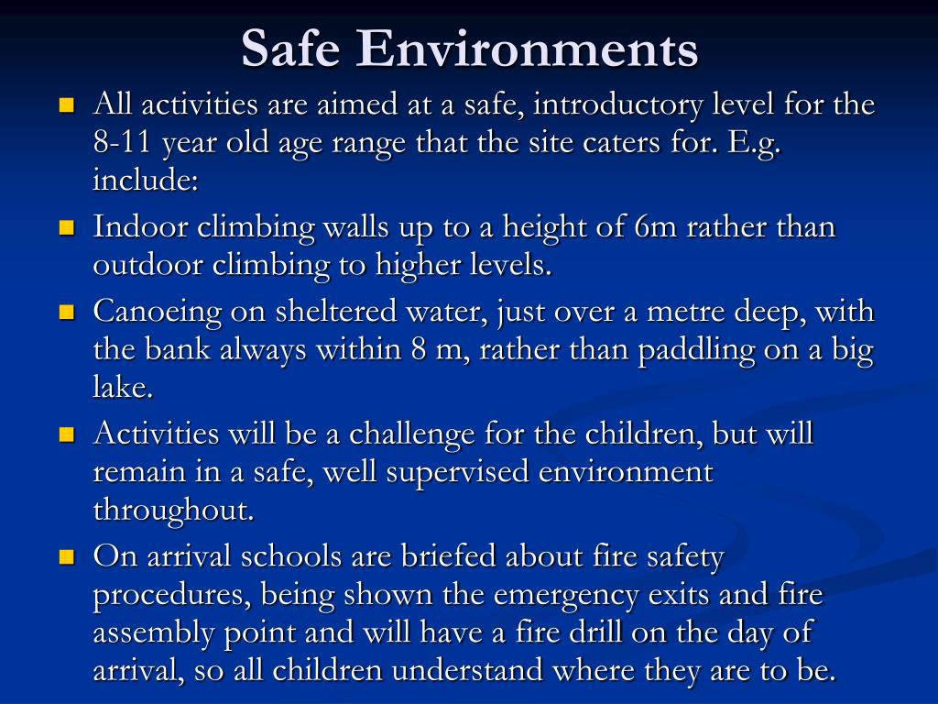

Slide 14
Behaviour Expectations.
We will follow the code of conduct that has been given to us by the Robinwood activity centre.
We would like you to go through this with your child so that they know what will be expected of them with regard to their behavior whilst they are away with us.
As a school staff we will also expect that the children follow our Buxworth school rules and values.
If there is any disregard for these or if there is any behavior that is deemed unsafe then we will phone you and immediately ask you to collect your child from the trip.

Slide 15
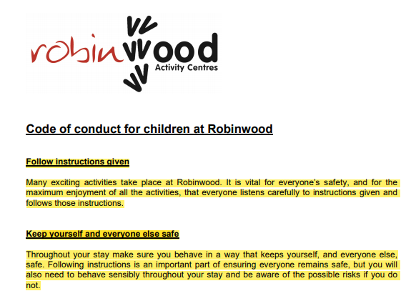
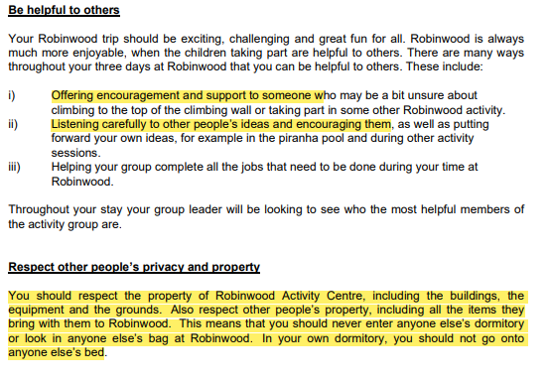
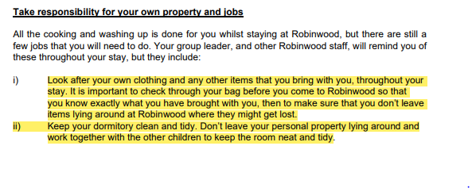
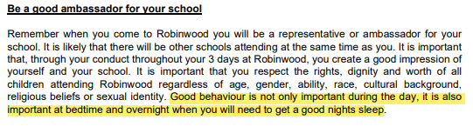

Slide 16

Notes:
We have chosen some of these qualities that we feel our class would benefit from working on.

Slide 17
Medication
Will be kept in a locked box and will be administered by a Buxworth school staff member as required.
Any children needing inhalers will need to keep their own with them at all times. This can be given to a member of Buxworth staff or their instructor for their day-time activities- PLEASE ALSO send a spare for the medical box.
PLEASE ONLY send any medication you have said is essential on the form.
Please be aware that it is a reasonable length coach journey. So if there is any chance that your child gets travel sick, ensure that they have had medication before they leave in the morning and please hand in some for the journey home!
We will collect any medication from you on the morning of departure along with the medication form that you have filled in with specific instructions. We will complete this and return it to you at the end of the trip.

Slide 18
MEAL TIMES
The children will be able to choose from a selection of healthy nutritious foods available at each meal. (Carb Heaven!)
We have let the centre know if there are any specific dietary requirements this is in accordance with what was entered on the forms returned to school.
They are not allowed to bring any snacks or sweets for the journey, or with them in their bags to eat at night.
They will need to bring with them their named water bottle. They can refill this each day.
They get regular drink and snack breaks during the day, fruit and biscuits are on offer.
The children are all offered hot chocolate and a biscuit before bed during the evening time activity.

Slide 19
Over to you !
Any other questions ? ?

